Slide 1
WhatsChat - Programmieraufgabe 1
Timon Baldow 384023
Leonard Kinzinger 393510
Jan Tiegges 393523
Mika Dietz 394284
AWSys HA 01: Gruppe 52

Slide 2
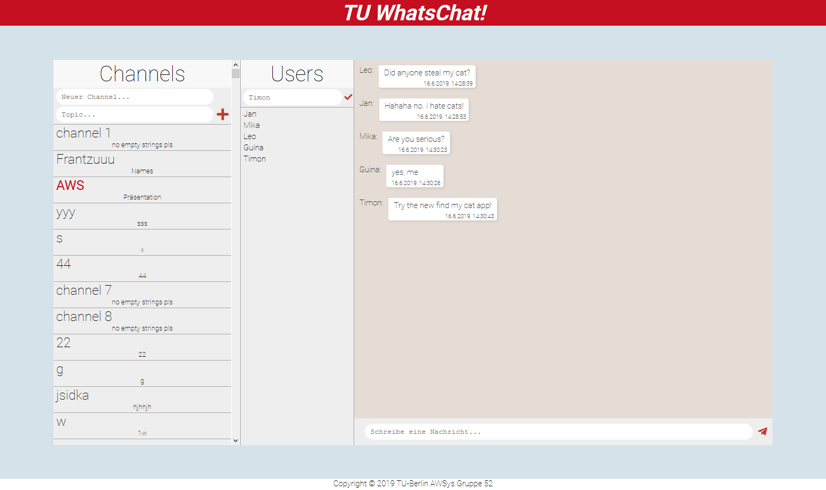
Overview
Option to add Channel with Channel name and topic
Click the + button to create channels on Server
All channels that exist on the server are displayed in the scrollable list below.
The currently viewed channel is marked in red.
The user can switch channels by selecting a channel.

Slide 3

Overview
Option to add a user name in input field. The placeholder and default value for the user name is anonymous.
Click the check button to apply the new username to the chat.
All the current users with their corresponding user names are displayed in the list.

Slide 4
Overview
The last 10 messages (implemented on server) are displayed in the chat window.
Each message contains a user name, content and a timestamp.
The text area enables one to send messages to the current channel. You can either send the messages by clicking on the paperplane or hitting enter.

Slide 5
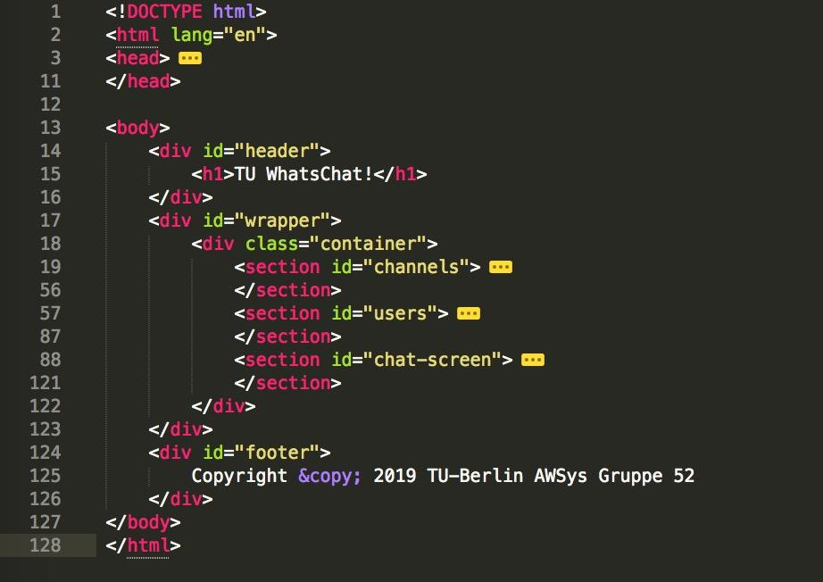
General HTML
HTML

Slide 6
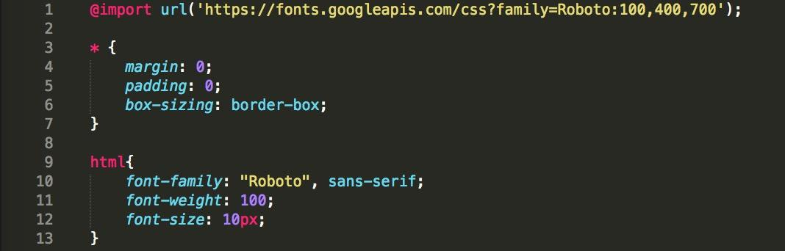
General CSS
CSS

Slide 7
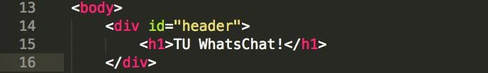
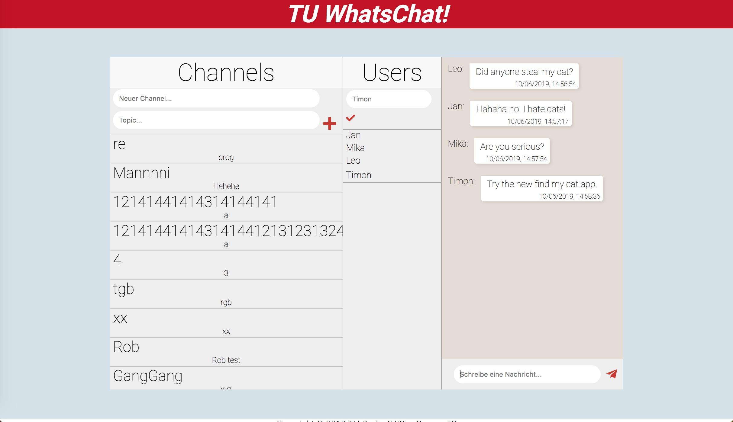
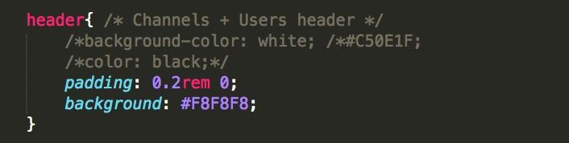
Header
HTML
CSS

Slide 8
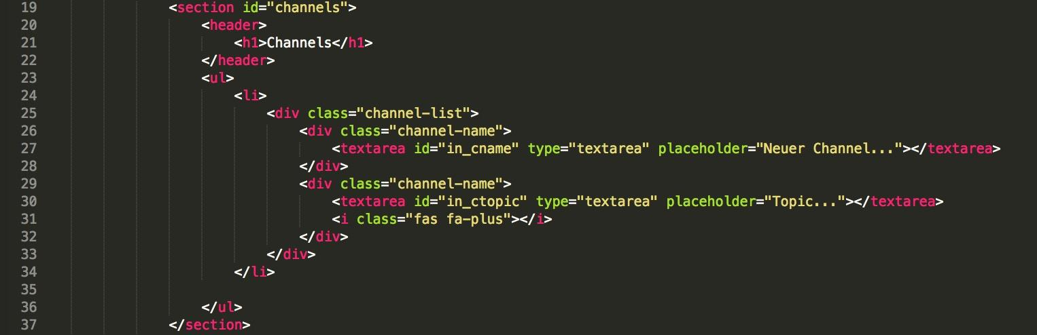
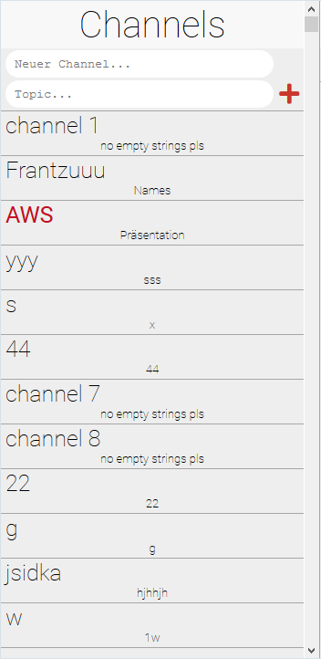
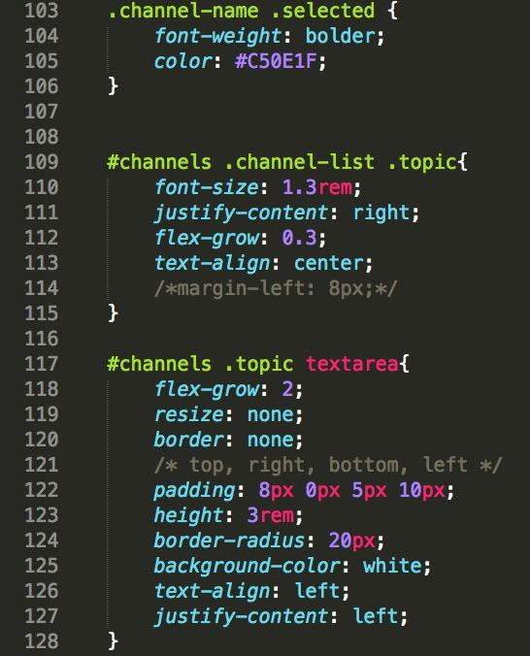
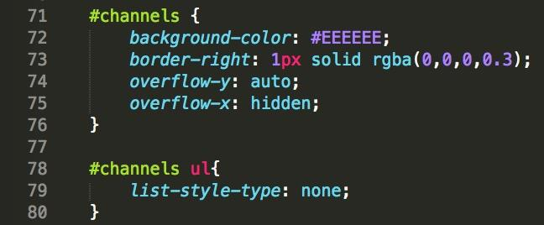
Channels
HTML
CSS
Channels will be appended to unordered list by Javascript (see Channels Javascript - _addChannelToScreen())
Not all CSS is displayed here, for more, see style.css

Slide 9
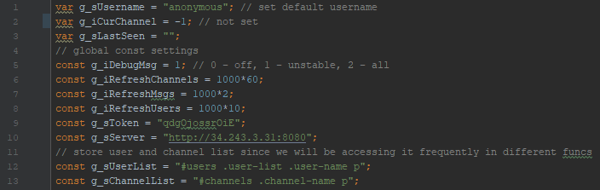
Basic JavaScript
→ Global script constants are used to ensure efficiency.
→ Script-wide unified variable names.
Standard: A variable starts with a lowercase letter indicating the proposed variable type (since JS uses variants this helps avoid accidental casting). For example: s → String, i → Integer, a → Array.
After the indicator the actual name follows starting with a capitalized character
Global variables: Start with „g_“ followed by their standard unified variable name.

Slide 10
Channels
JS
All available Channels will be loaded from server by the _getChannels() function
setInterval(_getChannels, g_iRefreshChannels) is used for background polls every 60s (g_iRefreshChannels)
If user clicks + button to create Channel $("#channels i").click(function () will be called which then calls _createNewChannel(sChannel, sTopic) to perform Ajax POST call to the server
To add the channels to the list, the function _getChannels() calls _addChannelToScreen(iID, sChannel, sTopic = '')
If user switches the channel by clicking on any channel item in the list the function _switchChannel(sChannel) will be called by the .click event
We also implemented a function _prepChannelName() to trim whitespaces, set type to String and block code injection

Slide 11
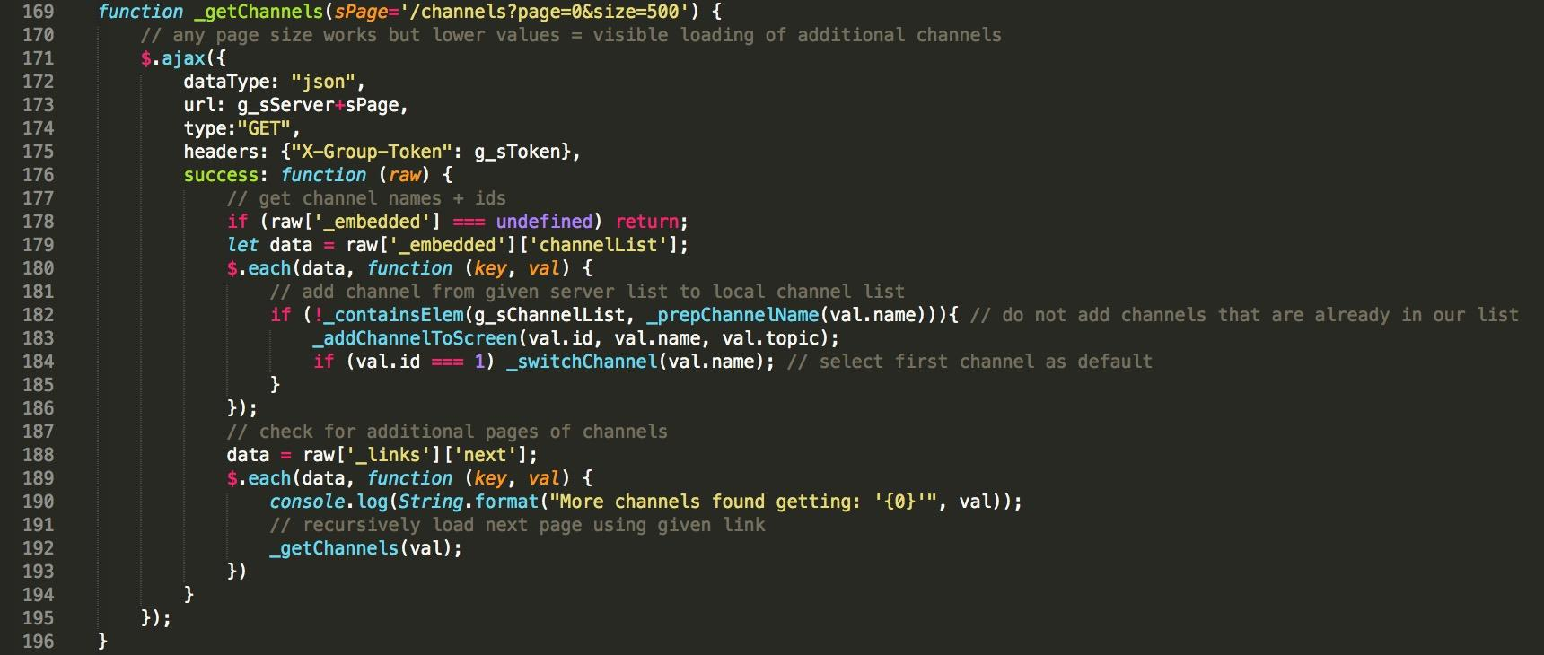
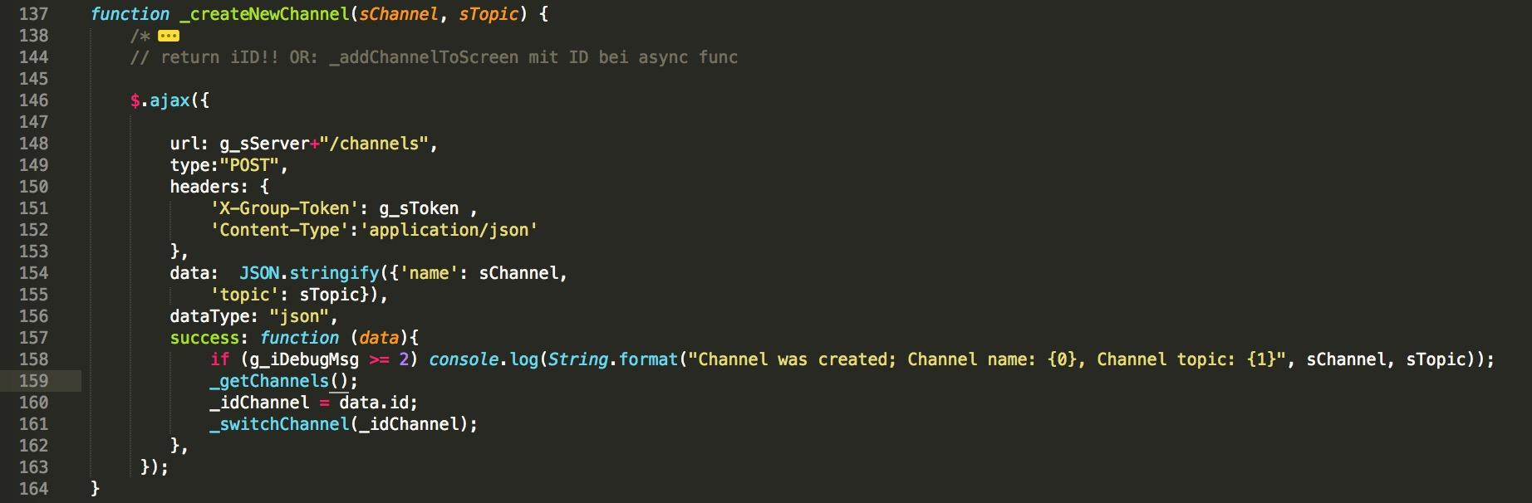
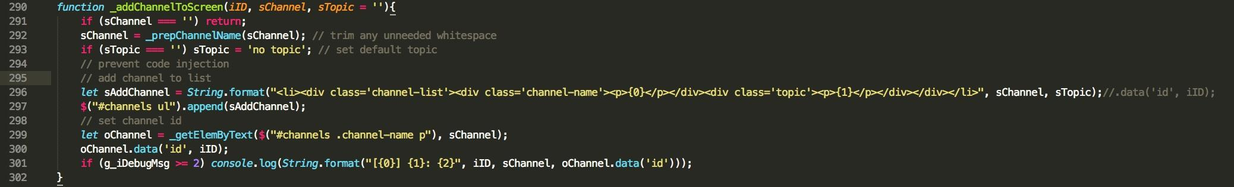
Channels
_getChannels()
_createNewChannel()
_addChannelToScreen ()

Slide 12
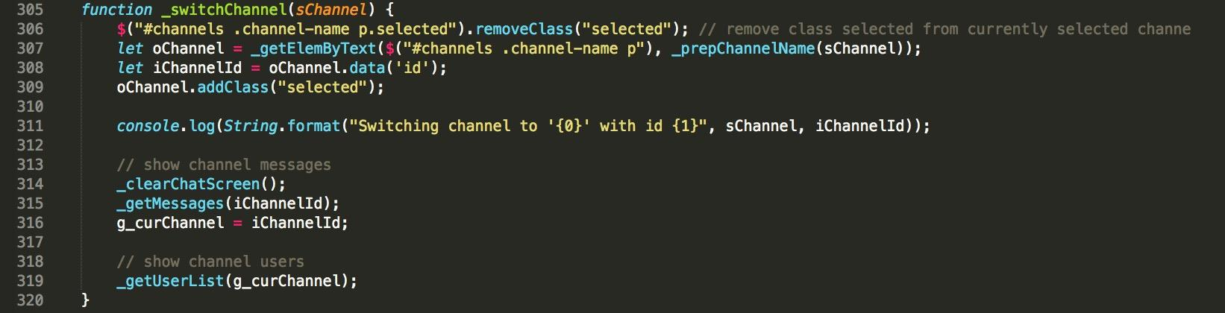
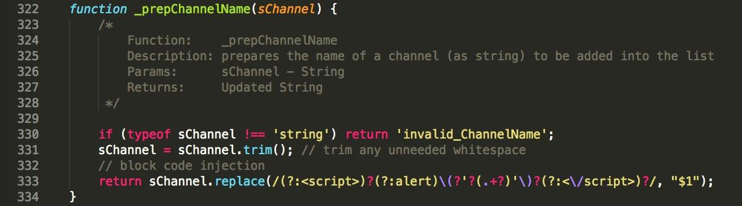
Channels
_switchChannel()
_prepChannelName()

Slide 13
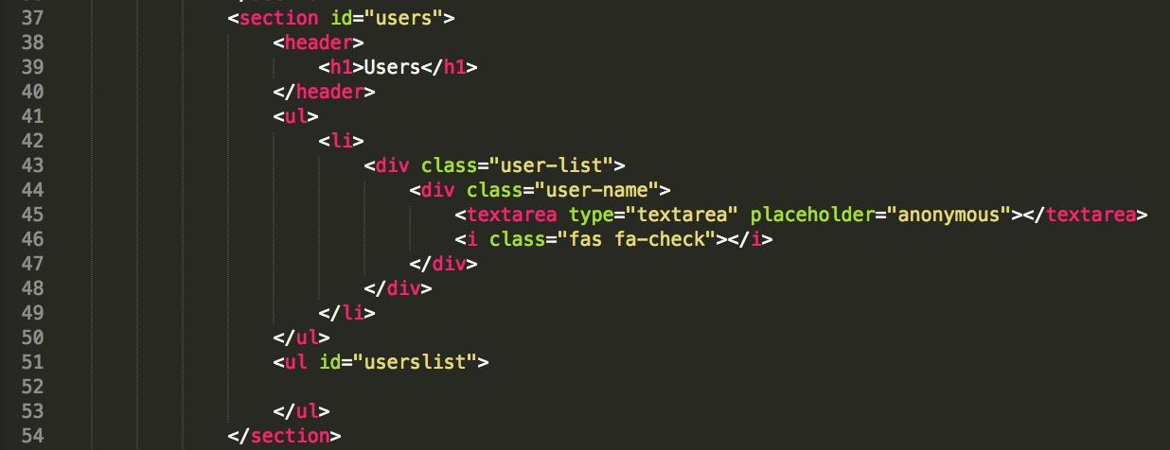
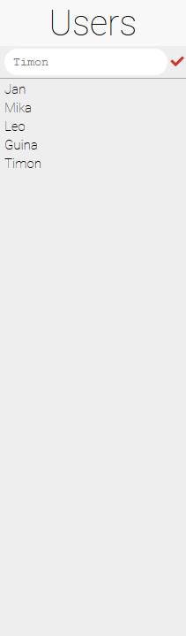
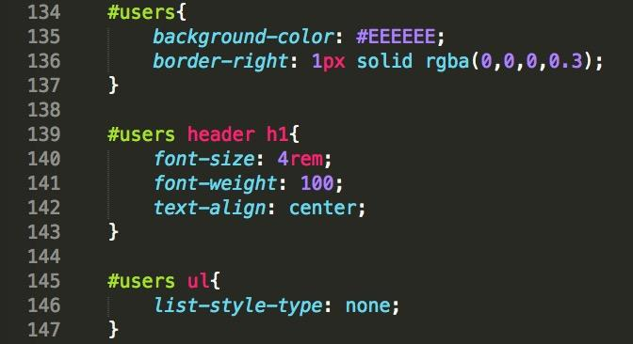
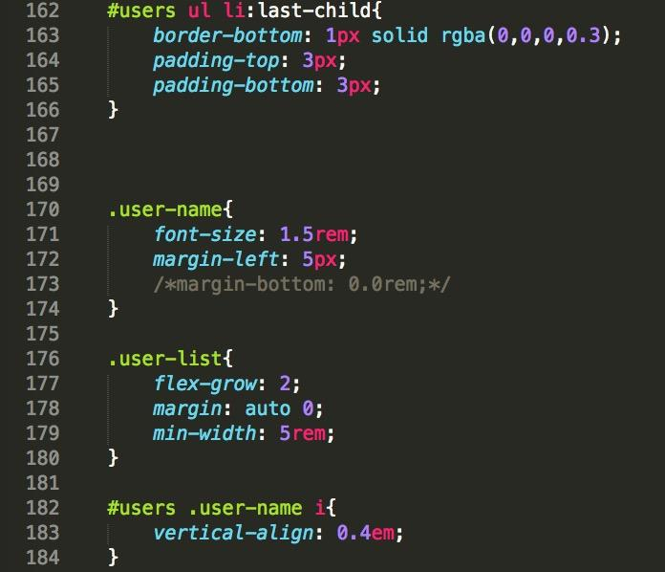
Users
HTML
CSS

Slide 14
Users
JS
All available Users in the current channel will be loaded from server by _getUserList() upon channel join
setInterval(_updateUserList, g_iRefreshUsers) is used for background polls every 10s (g_iRefreshUsers)
_updateUserList() fetches the list of online users from the server for the current channel (if a channel has been joined)
The users menu allows one to set the user name for the current channel. This is done by adding the preferred name in the input field and clicking the check button
This triggers the on click event which reads the input, changes the internal value, and sets the placeholder attribute to the input value
If no user name is set anonymous is used as default name
The _getUserList(iChannel) function clears the user list pulls the current users of a given channel from the server using an ajax call
For every user in the ajax response the _addUserToScreen(sUsername) function will be called to display the name
The _addUserToScreen(sUsername) function than adds the content in an html wrapper to the list (see JS)

Slide 15
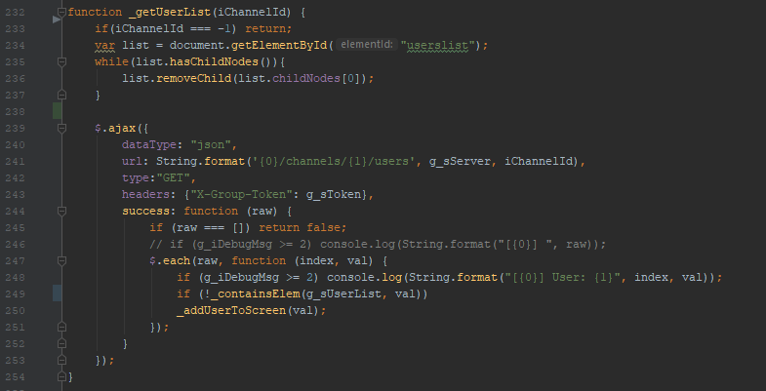
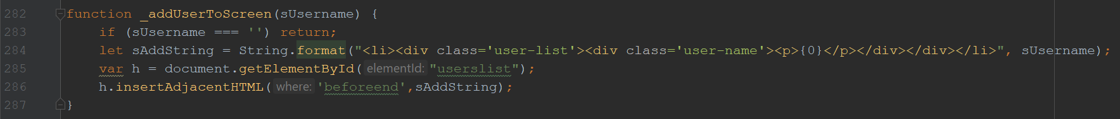
Users
_getUserlist()
_addUsersToScreen()
_updateUserList()

Slide 16
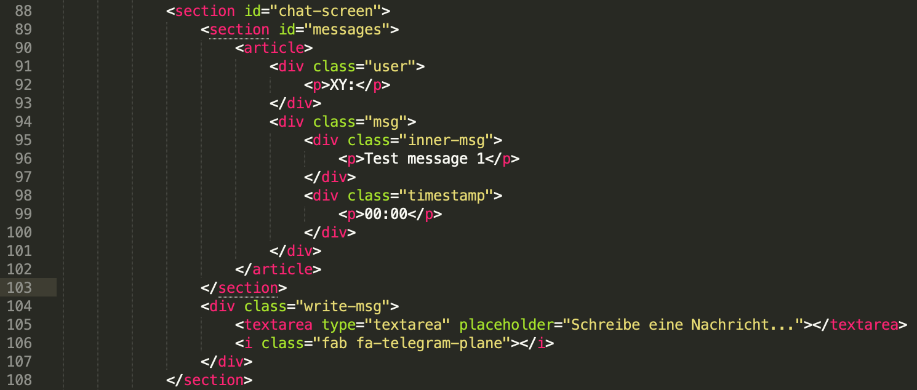
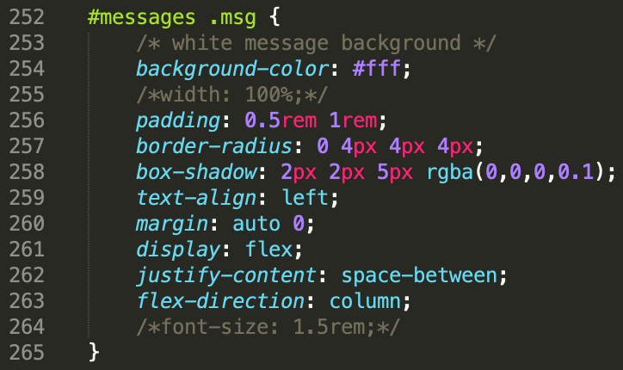
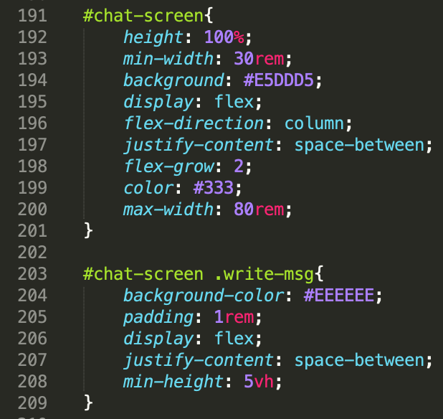
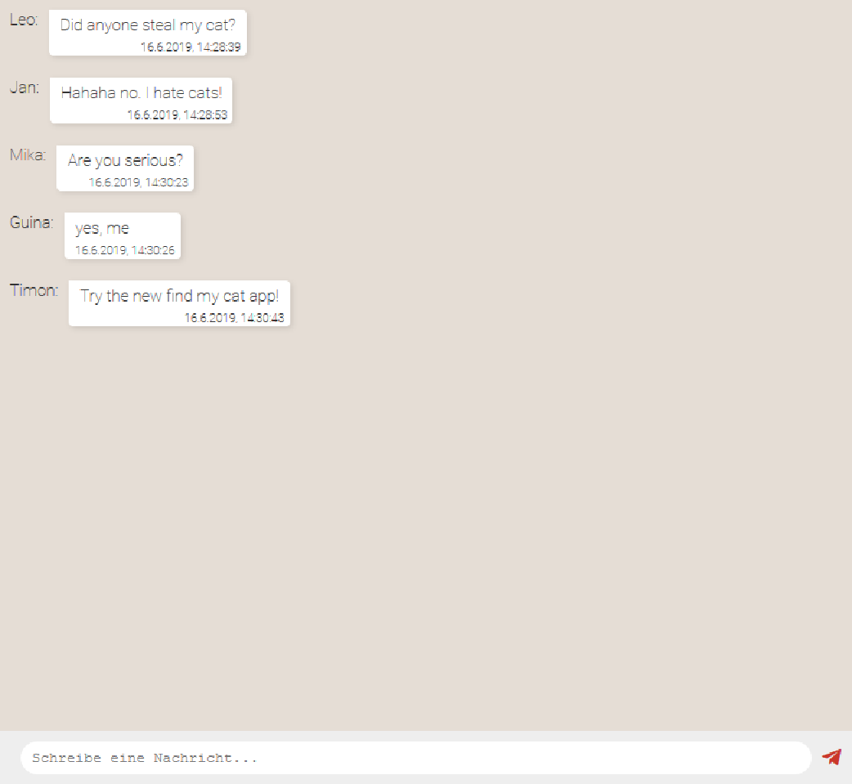
Messages
HTML
CSS
Not all CSS is displayed here, for more, see style.css

Slide 17
Messages
JS
All available Messages in the current channel will be loaded, when joined, from server by _getMessages(iCurChannel, sLastSeen)
setInterval(_updateMessageList, g_iRefreshMsgs) is used for background poll every 1s (see g_iRefreshMsgs)
This triggers the _updateMessageList() to check if user has joined any channel yet - if this is case the case the _getMessages() function will be called with the '?lastSeenTimestamp=' parameter of the last message and the encoded-to-url timestamp
The benefit is, that only the last messages will have to be loaded and the chat screen is continuous
To send messages users can use the textarea at the bottom of the chat window - either hitting enter or clicking the paperplane-telegram button. That will trigger the _inputHelper_ReadTextarea() function
This function checks for a valid entry and triggers the _sendMsg(sMsg, sSender) function and resets the input field
The _sendMsg() function will then perform a POST ajax call to the server and will update the message list and user list, if successful
This is done to have a smooth chat experience

Slide 18
Messages
JS
The _getMessages() will trigger the _addMsgToScreen(sMsg, sSender, timestamp = new Date(), bReverse=false) function.
This function checks if the input is valid and puts it into an html wrapper, that will be added to the unordered list from the html file.
It also checks if the function was called with the ?lastSeenTimestamp=' - in this case it adds the messages in reverse to show the messages in the correct order.
The bReverse parameter changes the order in which the messages will be added to the screen. This is useful when parsing the messages from the server since in that case the newest messages will be the first ones in the object - opposed to the standard case where only one new message is appended to the end of the screen.

Slide 19
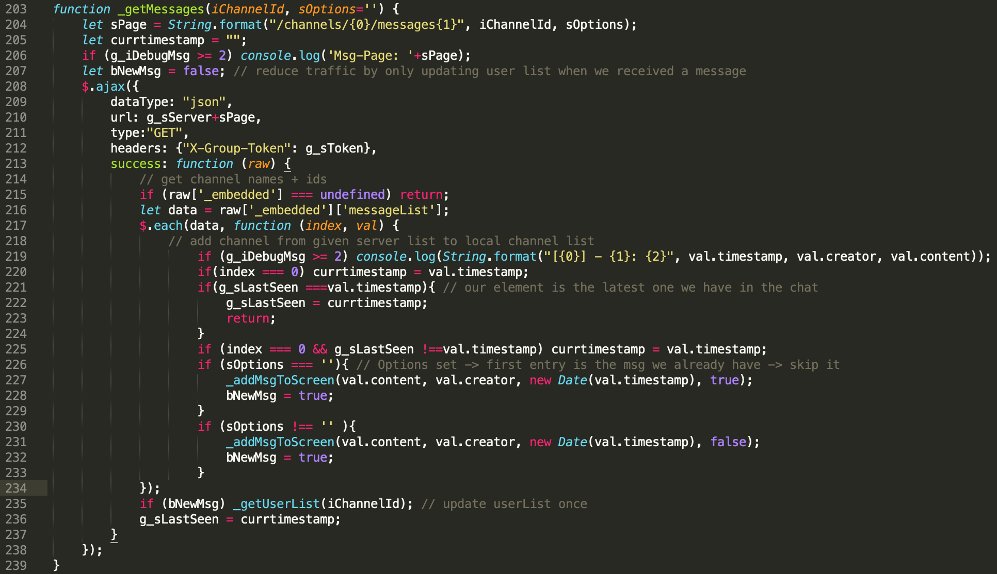
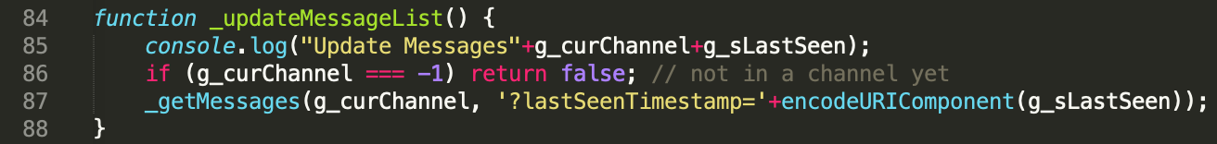
Messages
_getMessages()
_updateMessageList()

Slide 20
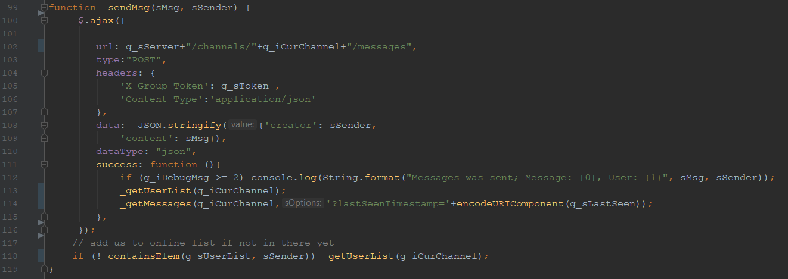
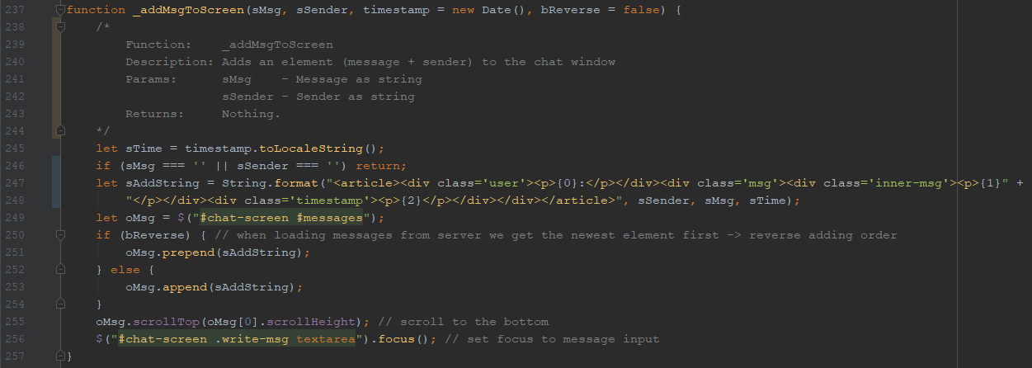
Messages
_sendMsg(sMsg, sSender)
_addMsgToScreen(sMsg, sSender...)

Slide 21
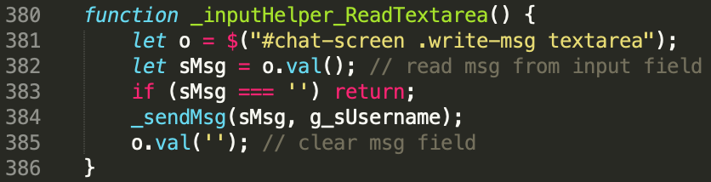
Messages
_inputHelper_ReadTextarea()

Slide 22
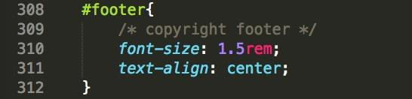
Footer
HTML
CSS

Slide 23
Distribution of tasks
Timon: HTML, CSS, JS, Presentation
Leonard: HTML, JS, Presentation
Jan: HTML, JS, Presentation
Mika: CSS, JS, Presentation

Slide 24
“Over and out”
Michael Jackson
Content and Design by: Leonard, Timon

